Slide 1
AI IN RETAIL
Alfredo Garza, Richard Rodriguez, Olaleye Bakare, Khizar Khan
02-Jul-2025

Slide 2

What is Retail
Retail is the sale of goods and services to consumers
Retail markets date back almost 10,000 years
The first recorded retail market was in Asia Minor (now Turkey). Now, AI in retail uses machine learning to change how retailers operate.
AI tools analyze datasets to predict demand, and adjust pricing on the fly.
Nearly 90% of retailers already use it to some extent in their companies.
Retail is the largest private-sector employer in the United States, supporting 52 million working Americans

Slide 3
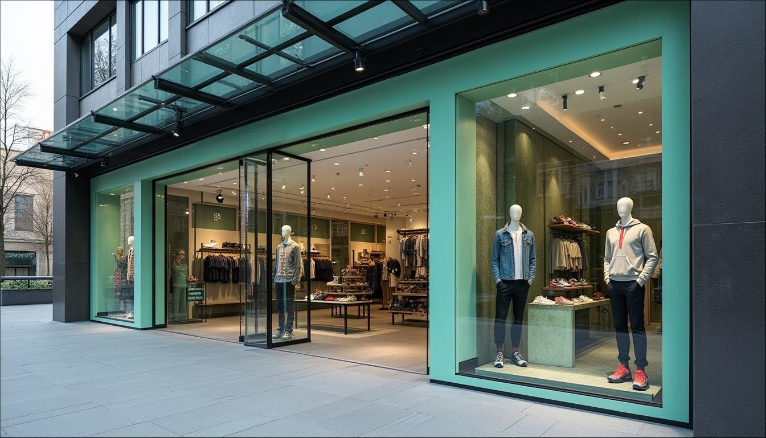
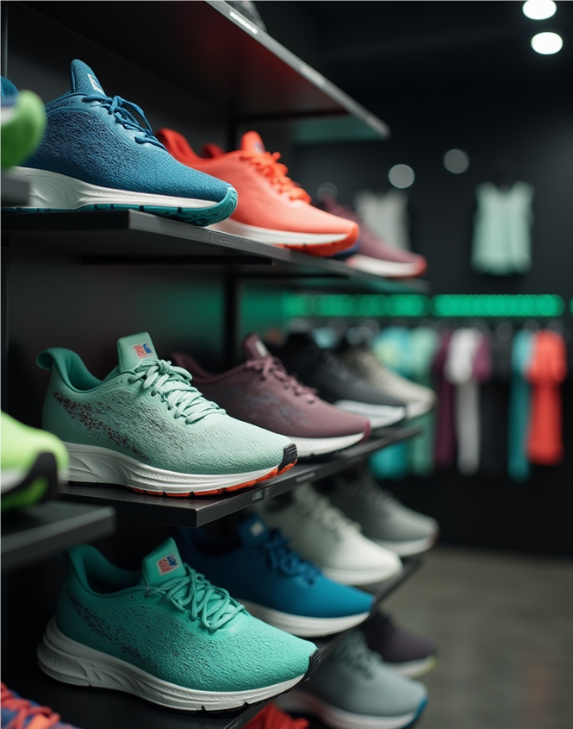
WHY is retail important?
Retail is the critical bridge between producers and consumers. It drives economic growth, creates millions of jobs, and shapes consumer culture. Retailers not only distribute goods but also influence trends, pricing, and innovation.
In short, retail is the heartbeat of the consumer economy—where supply meets demand in real time.

Slide 4
Use Case Motivation
Personalized Customer Experience
AI analyzes customer behavior, preferences and purchase history to deliver curated product recommendations.
Inventory & Supply Chain Optimization
AI can predict demand trends and will automate restocking based on the predicted demand.
Customer Service Automation
AI powered chatbots operate 24/7, greatly reducing the need for human agents.

Slide 5
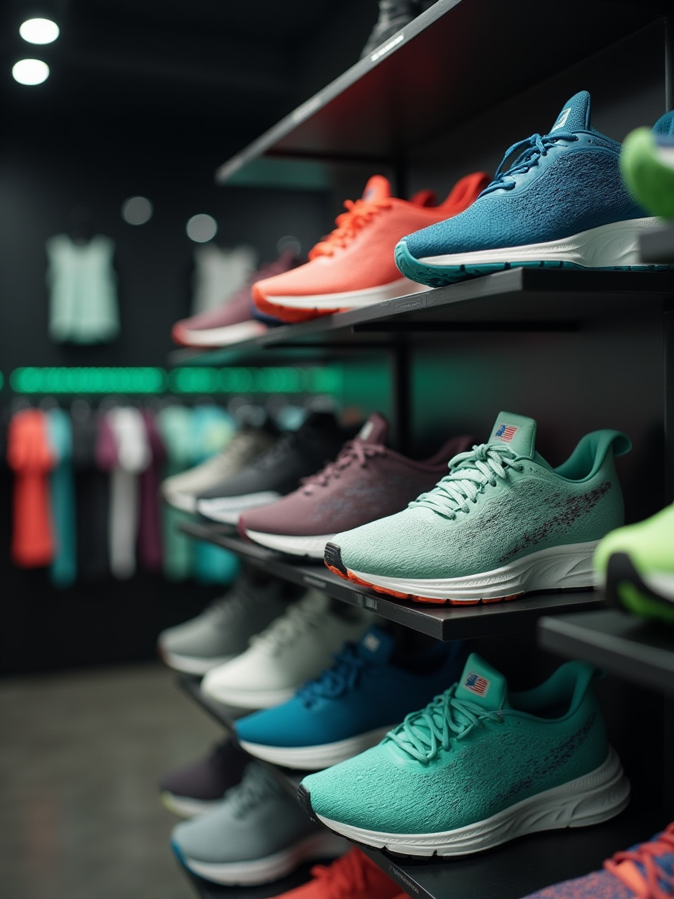
Oracle APEX AI Assitant
It is a low-code platform for building scalable, secure web apps that streamlines app deployment and integration with Oracle Cloud services
AI Assistant Integration:
- Natural language interface for retail teams and customers
- Embedded via REST APIs and PL/SQL connectors
- Enables predictive insights & real-time decision support
Retail Scenario: Customer asks, “What’s the best deal on sneakers today?”
AI Assistant Response (powered by Oracle APEX app):
- Scans inventory in real time
- Applies dynamic pricing rules
- Personalizes recommendation based on purchase history
- Offers promo code via chatbot user interface
Business Impact reported by Oracle
⏱️ Faster response time for customer queries
💰 Increase in promo-driven conversions
📊 Real-time sales analytics for managers via APEX dashboards
🔒 Secure, compliant data flow across customer journey

Slide 6
TECHNIQUES Used
Machine Learning
NLP
Forecast demand, optimize inventory, and personalize marketing.
Enhance customer service and sentiment analysis.
Computer Vision
Reinforcement Learning
Improve in-store operations and customer experience.
Optimize dynamic pricing and recommendation systems.

Slide 7
IMPACT & Benetifs
OPERATIONAL EFFICIENCY
COST REDUCTION
Automation of repetitive tasks like inventory tracking, pricing updates, and customer queries.
Automates labor-intensive tasks, optimizes logistics, and reduces waste
SUPPLY CHAIN OPTIMIZATION
SMARTER MARKETING
Predicts demand, avoids stockouts, and streamlines delivery routes
Enables targeted campaigns and dynamic pricing based on real-time data

Slide 8
CHALLENGES & Risks
SKILLS GAP
JOB DISPLACEMENT
Many retailers lack in-house expertise in AI and data science, making implementation difficult.
.
Automation of tasks like checkout or inventory management can reduce the need for human workers.
LEGACY SYSTEM INTEGRATION
CUSTOMER BACKLASH
Outdated infrastructure can hinder AI deployment and scalability.
Customer-facing AI (e.g., facial recognition, chatbots) can feel invasive or impersonal, leading to discomfort or distrust.

Slide 9
FUTURE Directions
Edge AI for Smart Stores - Processes data locally in stores (not just in the cloud) for real-time decisions. USE CASE: License plate recognition identifies loyal customers as they arrive for curbside pickup; AI handles drive-through orders with voice recognition.
Generative AI for Product Design & Content - Creates new product designs, marketing copy, and personalized content. USE CASE: AI generates clothing or furniture designs based on trends and customer preferences; it also writes product descriptions and social media posts.

Slide 10
DEMO Time
Transform Retail Media Campaign Launch—in Under 5 Minutes—with Generative & Agentic AI

Slide 11
CONCLUSION
AI is transforming retail by making shopping more personal and operations more efficient. It helps stores understand what customers want—offering tailored product recommendations, personalized promotions, and even virtual assistants that answer questions in real time. Behind the scenes, AI also keeps shelves stocked by predicting demand and automating inventory management, so customers find what they need when they need it. The result? A smoother, smarter retail experience for both shoppers and businesses.

Slide 12
RESOURCES
Did you like the resources used in this template? Get them on these websites:
AI-generated images by Freepik AI Image Generator
Cummings, A. R. (2025). AI in retail: Use cases, examples & adoption. Shopify. https://www.shopify.com/retail/ai-in-retail
Edureka. (2021, July 6). AI in retail Artificial intelligence in retail industry Future of AI in retail [Video]. YouTube. https://www.youtube.com/watch?v=-Y-jCpPCFHA
MongoDB. (2023, May 9). AI-driven retail demo: Auto-generate descriptions for faster product onboarding [Video]. YouTube. https://www.youtube.com/watch?v=7fKXd-KafLw
IHL Group. (2023, August 15). AI in retail: A look at retail's AI revolution study by IHL [Video]. YouTube. https://www.youtube.com/watch?v=4ewQofa_iU0
World Economic Forum. (2023). How AI is transforming the retail industry. https://www.weforum.org/agenda/2023/06/ai-retail-industry-transformation/
Thokala, R. (2024, June 14). Coding with the AI Powered APEX Assistant on Oracle APEX. Oracle Blogs. https://blogs.oracle.com/apex/post/coding-with-the-ai-powered-apex-assistant-on-oracle-apex

